Slide 1

Digital Design and Verification Training
Getting Started

Slide 2
Agenda
Introductions
Course Overview
Administrative Information
Basics of C

Slide 3
Trainers: EE Department UET, KICS
Dr. Muhammad Tahir Professor, Department of Electrical Engineering, UET Lahore
Mr. Umer Shahid Lecturer, Department of Electrical Engineering, UET Lahore
Mr. Rehan Naeem Lecturer, Department of Electrical Engineering, UET Lahore

Slide 4
Trainee's Introduction
Now it's your turn

Slide 5
Training Overview
Training objectives
Develop a strong foundation in digital design principles and computer architecture
Bridge the gap between academic knowledge and industry requirements
Cultivate practical skills in digital design tools and methodologies
Foster teamwork and communication skills essential for professional engineering environments

Slide 6
What you can Expect
1 month of coaching ~ 10k a month
Week-1: Productivity Tools
Week-2: Digital Systems Design
Week-3: Computer Architecture
Week-4: Digital Systems Verification
Hands on Projects ~ 10k a month
Complex datapaths and controllers
RISCV Microprocessor System Design
Verification
Software
Just like you’re working in a company

Slide 7
What is Expected of You
Attendance
Performance in Multiple Evaluations
Knowledge
Skill
Speed

Slide 8
What is Expected of You
Top-notch Communications
Daily Updates
What you have done today.
What you’re going to do tomorrow.
Are there any roadblocks?
Clarity and Accuracy
Spoken and Written
Independence
Task assignment to task completion
Doesn’t stop you from collaboration

Slide 9
Timings
Monday to Friday, 09.00 am to 04.00 PM
Coaching
09.00 am to 12.00 pm
Will include a couple of small breaks.
May end earlier than the allocated time.
Hands on Lab Sessions
12.00 pm to 04.00 pm

Slide 10
What's Next
Internship - 30k to 40k a month
Xcelerium’s Proprietary Projects
Full-Time Job - 130k to 150k a month

Slide 11
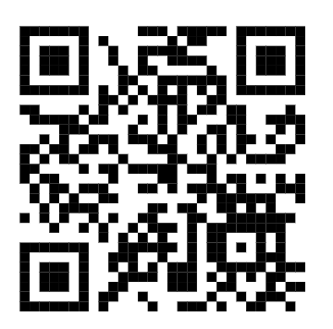
Administrative Information
Reporting procedure
Slack information
https://join.slack.com/t/xceleriumdigi-t6v9440/shared_invite/zt-3bif7sic2-YyHNbEca0DAqMuGnqK86iQ

Slide 12
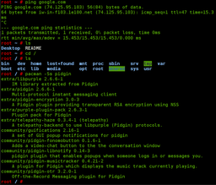
Linux Shell Scripting
Digital Design and Verification Training

Slide 13
Linux Shell Scripting
A shell is a program that commands the operating system to perform actions.
You can enter commands in a console on your computer and run the commands directly, or you can use scripts to run batches of commands.
Shells like PowerShell and Bash give system administrators the power and precision they need for fine-tuned control of the computers they're responsible for.

Slide 14
Shell Commands
The full syntax for a Bash command is:
command [options] [arguments]
Which options and arguments varies from command to command. To learn about the options for a command, use the man (for "manual") command.
man <command>

Slide 15
File and Directory Commands
Make directory
mkdir <name>
Navigating – cd <option>
cd ~
cd ..
List Contents
ls <name>
Removing directory
if empty – rmdir <name>
Not empty – rm –r <name>
Copy files or directories
cp <source> <dest>
Move or rename files or directories
mv <source> <dest>

Slide 16
Text Processing and File Commands
Creating
touch <file-name>
Concatenate and display file content
cat <file-name>
Search text using patterns
grep <pattern>
Replace Text in a file:
sed <text.to.replace> <file_name>

Slide 17
System Information
Print system information: uname
Display Linux processes: top
Report a snapshot of the current processes: ps

Slide 18
Copy command – cp
Copy files and directories
cp <name-to-be-copied> <name-of-the-copy>
if you use the -i (for "interactive") flag, Bash warns you before deleting existing files.
cp -i hello.txt bye.txt
copy all the files in the current directory to a subdirectory subdir1
cp * subdir1
To copy all the files in a subdirectory named subdir1 into a subdirectory named subdir2
cp subdir1/* subdir2

Slide 19
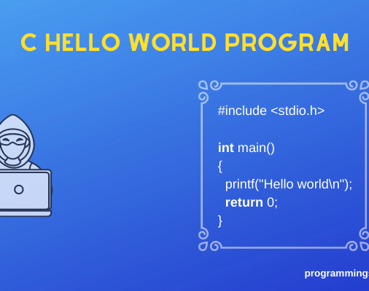
Basics of C Language
Digital Design and Verification Training

Slide 20
Quick Revision - C Language Essentials
Basic syntax and structure
Data types and variables
Operators and expressions
Control structures (if, switch, loops)
Functions
Arrays and strings

Slide 21
Basic Syntax and Structure
Structure of a C program:
#include <stdio.h> // Preprocessor directive int main() { // Main function // Your code here return 0; }

Slide 22
Basic Syntax and Structure
Basic data types
Size of data types
int age = 25; float pi = 3.14; double precise_pi = 3.14159265359; char grade = 'A';
printf("Size of int: %zu bytes\n", sizeof(int)); printf("Size of float: %zu bytes\n", sizeof(float)); printf("Size of double: %zu bytes\n", sizeof(double)); printf("Size of char: %zu bytes\n", sizeof(char));

Slide 23
Basic Syntax and Structure
Operators and Expressions
Increment/Decrement
int a = 10, b = 3; printf("Sum: %d\n", a + b); // 13 printf("Difference: %d\n", a - b); // 7 printf("Product: %d\n", a * b); // 30 printf("Quotient: %d\n", a / b); // 3 printf("Remainder: %d\n", a % b); // 1
int x = 5; printf("x: %d\n", x++); // Prints 5, then x becomes 6 printf("x: %d\n", ++x); // x becomes 7, then prints 7

Slide 24
Basic Syntax and Structure
If-else example
int score = 95; if (score >= 90) { printf("Grade: A\n"); } else if (score >= 80) { printf("Grade: B\n"); } else if (score >= 70) { printf("Grade: C\n"); } else { printf("Grade: F\n"); }

Slide 25
Basic Syntax and Structure
Switch example
char grade = 'B'; switch (grade) { case 'A': printf("Excellent!\n"); break; case 'B': printf("Good job!\n"); break;
case 'C': ​
printf("Average performance.\n"); ​
break; ​
default: ​
printf("Need improvement.\n"); }

Slide 26
Basic Syntax and Structure
For loop
While loop
for (int i = 0; i < 5; i++) { printf("%d ", i); } // Output: 0 1 2 3 4
int n = 1; while (n <= 5) { printf("%d ", n * n); n++; } // Output: 1 4 9 16 25

Slide 27
Basic Syntax and Structure
Function definition and call:
int square(int x) { return x * x; } int main() { int num = 4; printf("Square of %d is %d\n", num, square(num)); return 0; }

Slide 28
Basic Syntax and Structure
Array initialization and access
int numbers[] = {1, 2, 3, 4, 5}; for (int i = 0; i < 5; i++) { printf("%d ", numbers[i]); }

Slide 29
Basic Syntax and Structure
String operations
char str1[20] = "Hello"; char str2[] = " World"; strcat(str1, str2); printf("Concatenated string: %s\n", str1); printf("Length: %zu\n", strlen(str1));

Slide 30
Basic Demo
#include <stdio.h> #include <string.h> #define MAX_NAME_LENGTH 50 void greet(char* name) { printf("Hello, %s!\n", name); } int main() { char name[MAX_NAME_LENGTH]; printf("Enter your name: "); | fgets(name, MAX_NAME_LENGTH, stdin); name[strcspn(name, "\n")] = 0; // Remove newline greet(name); printf("Let's count to 5:\n"); for (int i = 1; i <= 5; i++) { printf("%d ", i); } printf("\n"); return 0; }

Slide 31
Advanced C Concepts - Pointers
Definition: A pointer is a variable that stores the memory address of another variable
Syntax:
Declaring and initializing pointers
int x = 10; int *ptr = &x; // ptr holds the address of x
int *p; // Declare a pointer to an int char *str; // Declare a pointer to a char double *dptr = NULL; // Initialize a pointer to null

Slide 32
Advanced C Concepts - Pointers
Accessing the value pointed to by a pointer
Example:
int x = 42; int *ptr = &x; printf("Value of x: %d\n", x); // 42 printf("Value pointed to by ptr: %d\n", *ptr); // 42 *ptr = 100; // Change the value of x through the pointer printf("New value of x: %d\n", x); // 100

Slide 33
Advanced C Concepts - Pointers
Incrementing and decrementing pointers
Example:
int arr[] = {10, 20, 30, 40, 50}; int *p = arr; // p points to the first element of arr printf("%d ", *p); // 10 printf("%d ", *(p+1)); // 20 printf("%d ", *(p+2)); // 30 p++; // Move to the next element printf("%d ", *p); // 20

Slide 34
Advanced C Concepts - Pointers
Relationship between arrays and pointers
Array name as a pointer to its first element
int numbers[] = {1, 2, 3, 4, 5}; int *ptr = numbers; // ptr points to the first element for (int i = 0; i < 5; i++) { printf("%d ", *(ptr + i)); // Access elements using pointer arithmetic } printf("\n"); // Equivalent array notation for (int i = 0; i < 5; i++) { printf("%d ", numbers[i]); }

Slide 35
Advanced C Concepts - Pointers
Accessing elements of 2D arrays using pointers
Example
int matrix[3][4] = {{1, 2, 3, 4}, {5, 6, 7, 8}, {9, 10, 11, 12}}; int (*p)[4] = matrix; // Pointer to an array of 4 integers printf("%d ", *(*(p+1)+2)); // Accesses matrix[1][2], prints 7 printf("%d ", p[1][2]); // Equivalent array notation

Slide 36
Function Pointers - Basics
Definition: Pointers that point to functions
Syntax:
Example:
return_type (*pointer_name)(parameter_types);
int add(int a, int b) { return a + b; } int (*func_ptr)(int, int); func_ptr = add; printf("Sum: %d\n", func_ptr(5, 3)); // Calls add(5, 3), prints 8

Slide 37
Function Pointers – Example
int compare_ints(const void* a, const void* b) { return (*(int*)a - *(int*)b); } int main() { int numbers[] = {42, 13, 7, 87, 35}; int n = sizeof(numbers) / sizeof(numbers[0]); qsort(numbers, n, sizeof(int), compare_ints); for (int i = 0; i < n; i++) { printf("%d ", numbers[i]); } printf("\n"); return 0; }

Slide 38
Common Pitfalls with Pointers
Uninitialized pointers
Dangling pointers
Memory leaks
Best Practices for Using Pointers
Always initialize pointers
Check for NULL before dereferencing
Use const when appropriate
Be cautious with void pointers
Free dynamically allocated memory

